Slide 1


LUNG CANCER DETECTION AND CLASSIFICATION USING IMAGE PROCESSING AND CNN-DEEP LEARNING ARCHITECTURE
RG
416
8 Credits

Slide 2




Team composition
RG
SL. NO | Name of the student | SRN | PHOTO
01 | Rhitesh Kumar Singh | PES1201700254
02 | Rajath Gadagkar | PES1201700136
03 | Dhruv K.C | PES1201701265
04 | Nitin Kumar P | PES1201701837
Guide : Prof. H R Vanamala

Slide 3
Contents
RG
1)Problem Statement
2)Motivation
3)Literature Review
4)Methodology
5)Block Diagram
6)Dataset
6)Pre-processing
7)Convolutional Neural Networks
8)Results and Comparison
9)Modification/Novelty
10)Conclusion
11)Project Timeline
12)References

Slide 4
Problem Statement/Objective
RG
Detection and classification of lung cancer from CT scan images using image processing techniques and CNN
Comparison of performance with different neural networks based on accuracy

Slide 5
Motivation
D
According to the Indian Council of Medical Research cancer registry, there were 57,795 new cases of lung cancer in 2012, which as projected has risen to 67,000 new cases in the year 2020. More importantly, the high disease-attributable mortality makes this condition an important public health issue
Early detection is important because when abnormal tissue or cancer is found early, it may be easier to treat or else the cancer could have spread and might be harder for treatment

Slide 6
Literature Review
D
Title | Methodology | Advantages | Disadvantages
Lung Cancer Detection using CT Scan Images [1] | They used Support Vector. Machines (SVM) for classification of cancer as benign or malignant. In the pre-processing stage, median and gaussian filters are used. The processed image is segmented using watershed segmentation. | Detected lung cancer as malignant or benign and removed salt-pepper noises and speckle noise that creates false detection of cancer. | The accuracy of the model using SVM was 86.66% which is not satisfactory.
Lung Cancer Detection Using Machine Learning Techniques[2] | Used SVM as its classifier to classify the nodule images into malignant or benign and to classify the lung cells into malignancy levels. | Structural Co-Occurrence matrix (SCM) is used for feature extraction. | The cancerous nodules could not be detected accurately since no pre processing techniques were used. Accuracy is not satisfactory.
Image processing techniques for analyzing CT scan images towards the early detection of lung cancer [3] | used Artificial neural networks as the classifier. Used image pre-processing, image erosion, median filtering, thresholds and feature extraction for image processing techniques. Binarization was used for image segmentation. | ANN was implemented Image pre-processing was also done. | Accuracy is not satisfactory. Better neural networks can be used to increase the accuracy.

Slide 7
Literature Review
D
Lung Cancer Detection Using Artificial Neural Network [4] | A feedforward network was used. Model was trained using predefined attributes. | The ANN model used had a training error rate of less than 1% which thereby leads to a better accuracy. | Better neural networks like CNN could be used to overcome the challenges of feedforward networks.
Convolutional Neural Networks Promising in Lung Cancer T-Parameter Assessment on Baseline FDG-PET/CT [5] | The algorithm was composed of two networks: a feature extractor and a classifier. Both models were trained with the Adam algorithm | Adam’s algorithm was used since the data set was quite large and the images were too noisy | The algorithm achieved an accuracy of 87% which could be better.
Lung Cancer Detection Using Machine Learning [6] | The features are extracted based on DTCWT and PNN as a classifier. | In case of the PNN Existing weights will never be alternated but only new vectors are inserted into weight matrices when training. | The algorithm achieved an accuracy of 63% which is not satisfactory

Slide 8
Literature Review
RG
An Effective Lung Cancer Detection And Classification Using Enhanced Fully Convolutional Neural Networks[7] | Used a gaussian filter in the pre-processing stage. used a fully convolutional neural network. | use of enhanced FCN helps to increase the F1 score | Fully convolutional neural networks are incredibly computationally expensive.
Lung Cancer Detection by using Adam Algorithm and Convolutional Neural Network[8] | uses histogram equalization and thresholding segmentation in pre processing stage. An additional adam algorithm is implemented along with the CNN model. | Adam’s algorithm is easy to implement. Works well with large data sets and large parameters. | Thresholding is done based on histogram peaks only which could lead to lower accuracy in image segmentation. An accuracy of 87% was achieved with this methodology
A Comparison between Different Segmentation Techniques used in Medical Imaging[9] | Comparison between different segmentation methods like watershed, threshold, k mean clustering, region seed, fuzzy C. | Region seed growing algorithm was found to be the best image segmentation algorithm. | Region seed growing algorithm is expensive in terms of time and memory. Also it depends on the user input to get the value for the initial seed.

Slide 9
Methodology
RG
Image is preprocessed using median, gaussian filters and Adaptive Histogram Equalization to reduce noise and enhance the contrast
Nodules are then segmented out of the image using watershed transformation with thresholding
Lastly, CNN-Deep Learning is used to classify the detected nodules as cancerous or not

Slide 10
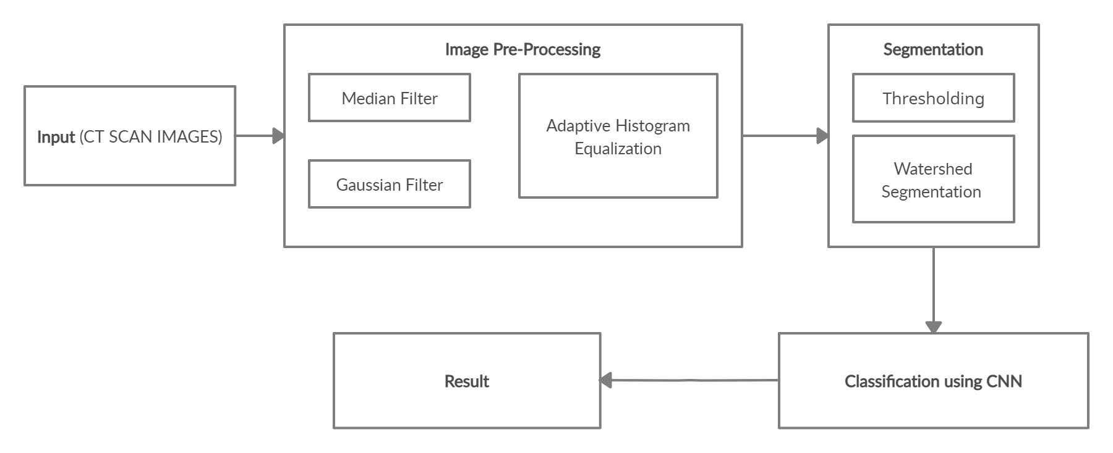
Block Diagram
RK

Slide 11
Dataset
D
Dataset Link | Number of Images | Dataset Formats
https://www.kaggle.com/kmader/siim-medical-images | (100 images) | Dicom/tiff (.dcm/.tiff)
The dataset is a subset of images from the cancer imaging archive
It consists of all CT images taken where valid age, modality, and contrast tags could be found
The metafile consists of the Patient ID, Contrast Tag, Age and Contrast
Wherever Contrast is TRUE - it means it is malignant and when it’s FALSE - it means it is benign

Slide 12
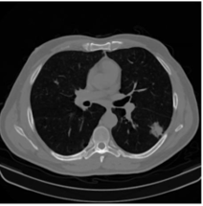
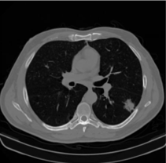
Pre-Processing
D
Original Image
Median Filter

Slide 13

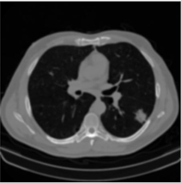
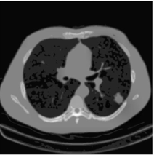
Pre-Processing
D
Gaussian Filter
Adaptive Histogram Equalization

Slide 14
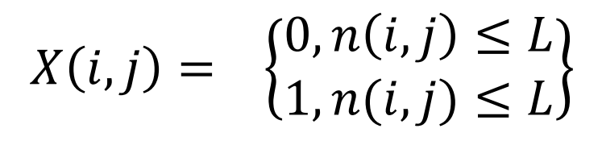
Segmentation
NP
Thresholding:
This technique is based on a threshold value to turn a gray-scale image into a binary image
In this technique image is segmented by comparing pixel values with a predefined threshold limit L
The equation to define the threshold level is given by:
Watershed Segmentation
Watershed is based on morphological process mixed with edge based segmentation to yield a hybrid technique
It is used to detect and separate out touching/overlapping objects in images which will help in segmenting the nodules

Slide 15
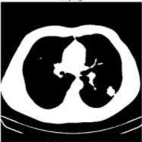
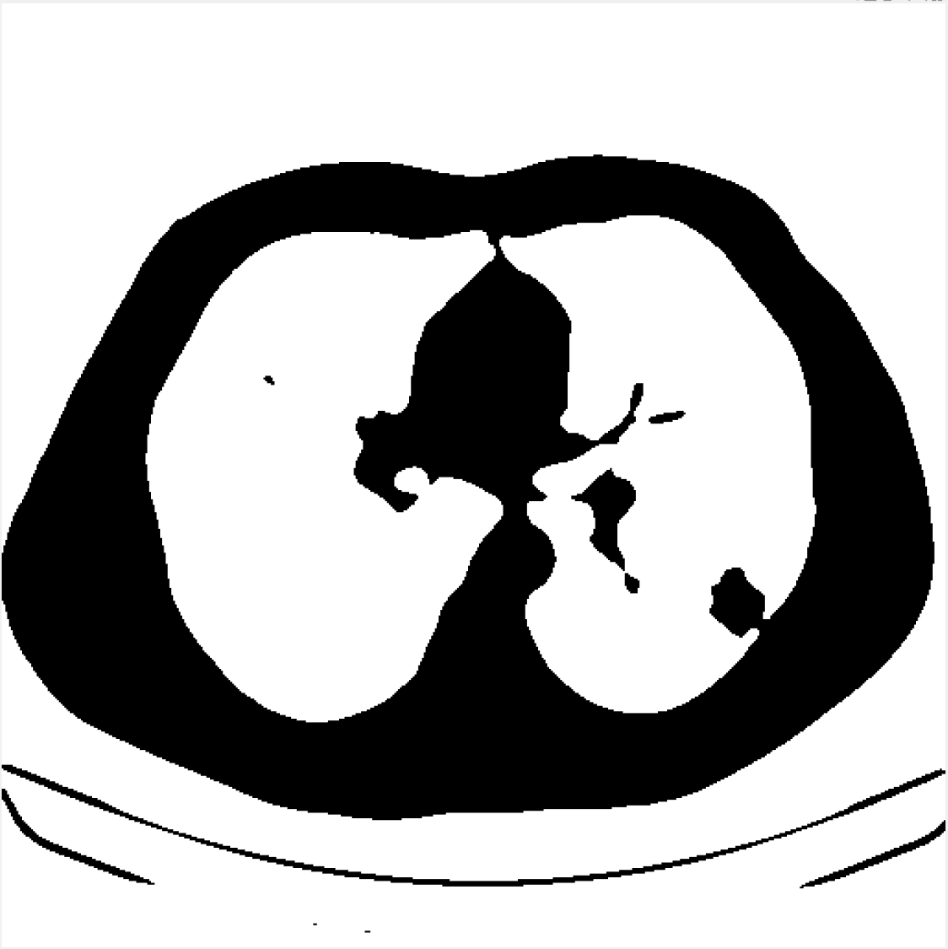
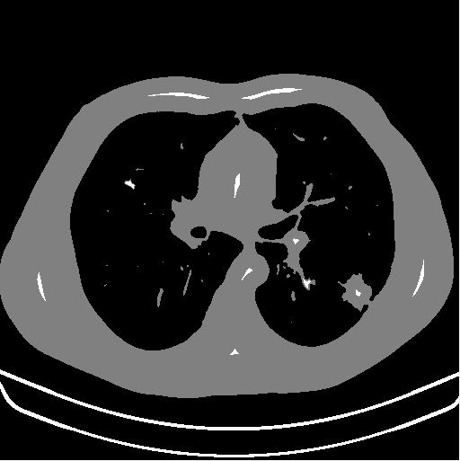
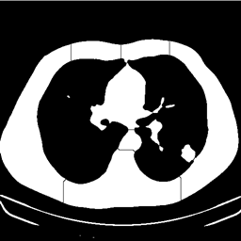
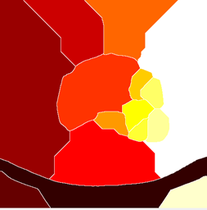
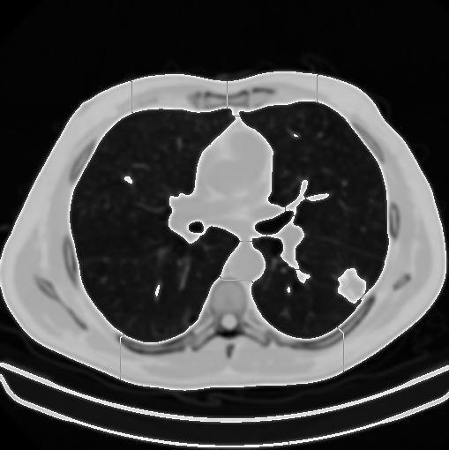
Segmentation
NP
Binary Image
Complement of Binary Image
Grayscale Mask
Watershed Lines Image
Watershed Labels Image
Segmented Output

Slide 16
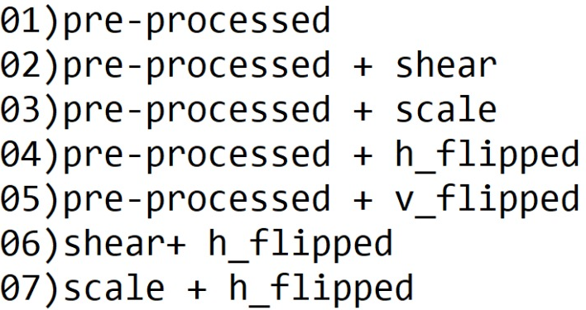
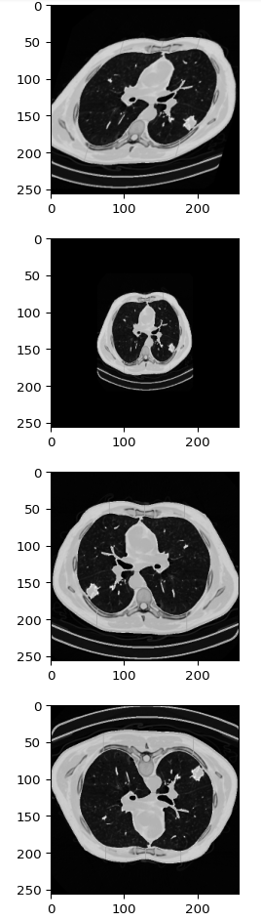
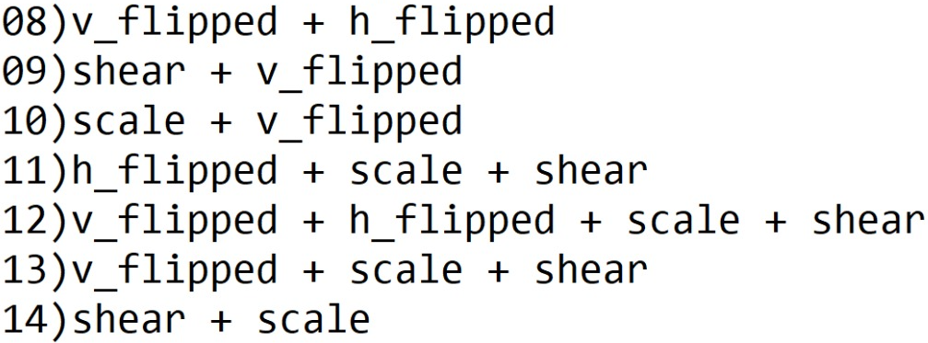
Data Augmentation
NP
Shear
Scale
Horizontally Flipped
Vertically Flipped

Slide 17
Convolutional Neural Networks
RK
Architectures used: LeNet, AlexNet, VGG16 & proposed model
Types of layers: Convolution, ReLU, Pooling, Fully Connected, Dropout & Batch Normalization layers
Activation functions: ReLU, softmax
Optimizer: Adam Optimizer
Evaluation metrics: Accuracy, precision, recall, F1 score, Macro Average, and Weighted Average

Slide 18
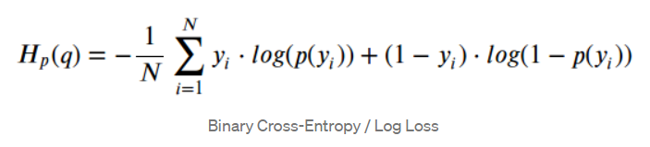
Binary Cross Entropy Loss Function
Binary cross-entropy compares each of the predicted probabilities generated by the model to the actual class output which can be either 0 or 1.
Where N = total number of probabilities
p= predicted probability
y = label value/ ground truth

Slide 19
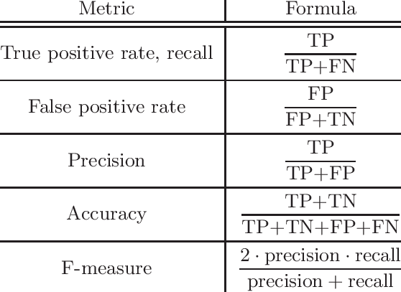
Evaluation Metrics
RK

Slide 20
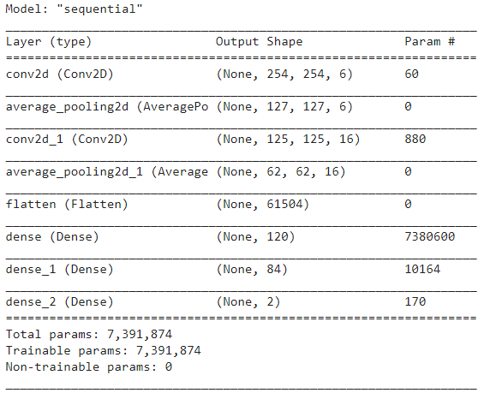
LeNet Architecture
D
Model Summary:

Slide 21
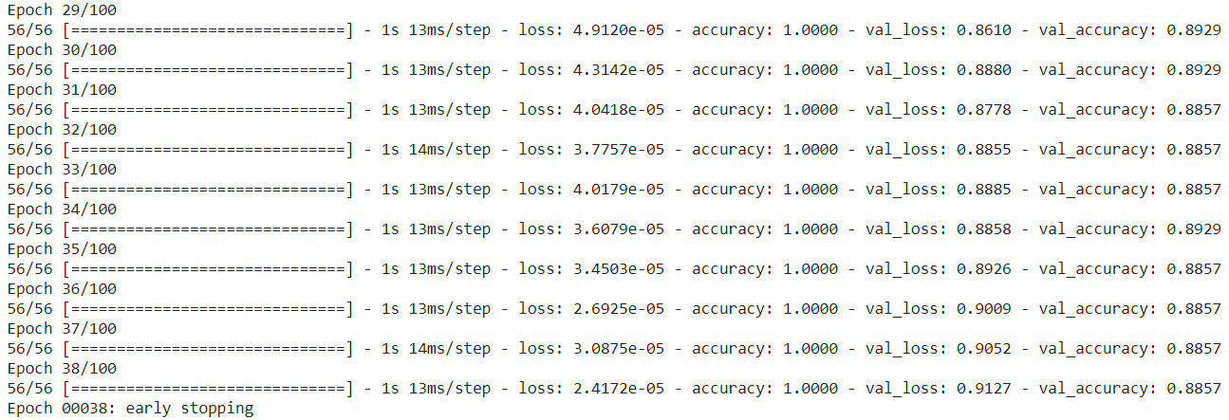
LeNet Results
D

Slide 22
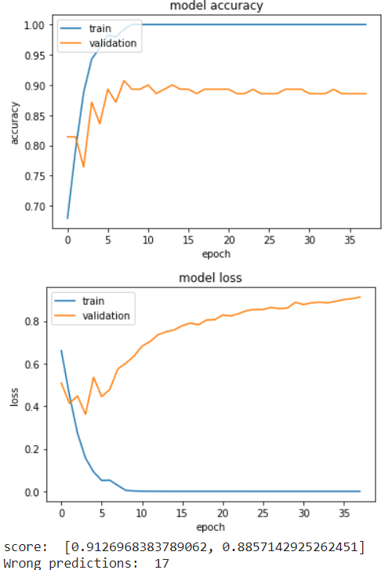
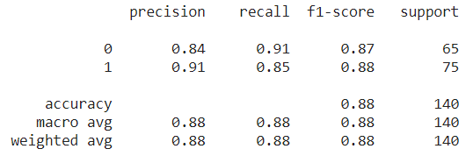
LeNet Results
D
Classification Report

Slide 23
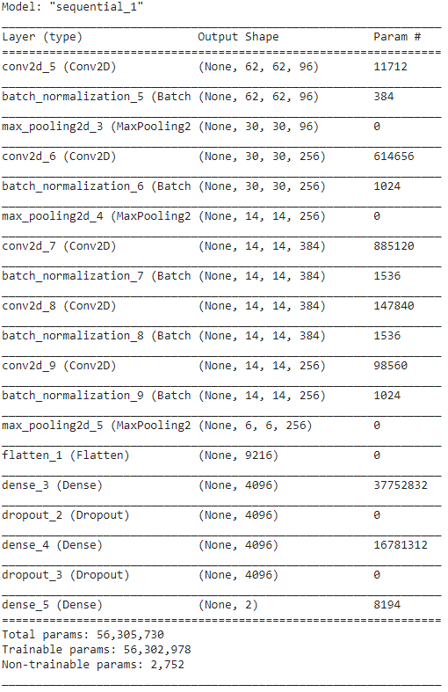
AlexNet Architecture
RG
Model Summary:

Slide 24
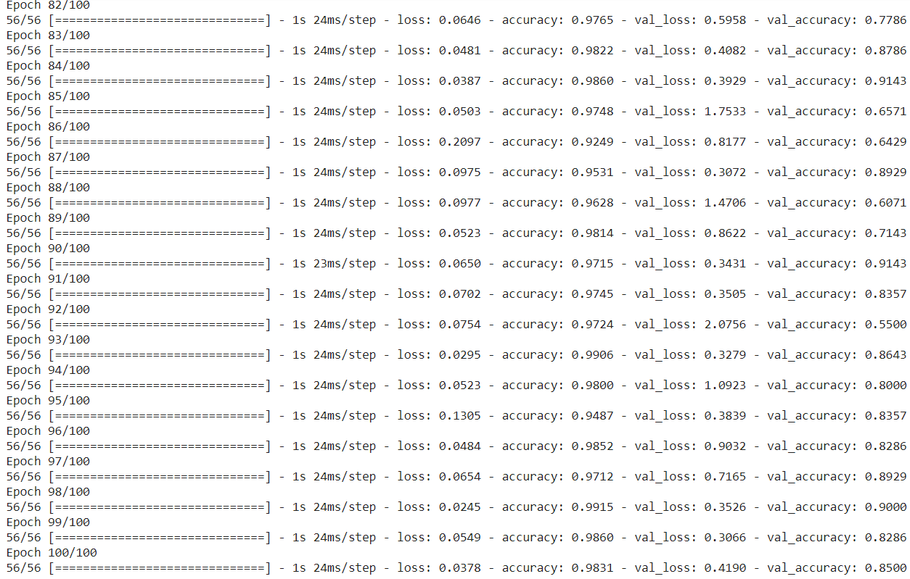
AlexNet Results
RG

Slide 25
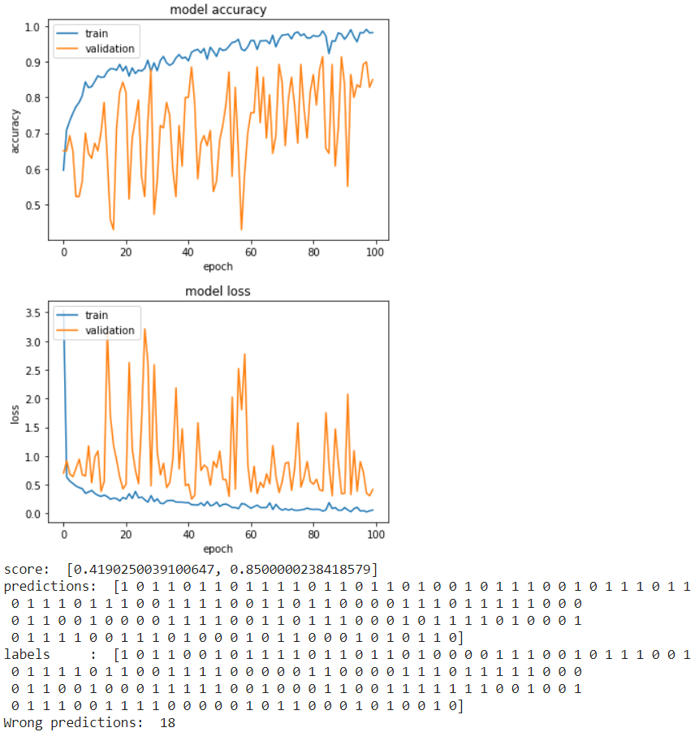
AlexNet Results
RG

Slide 26
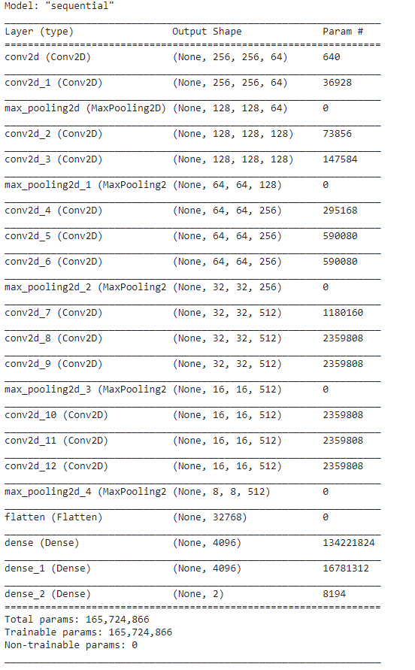
VGG16 Architecture
NP
Model Summary:

Slide 27
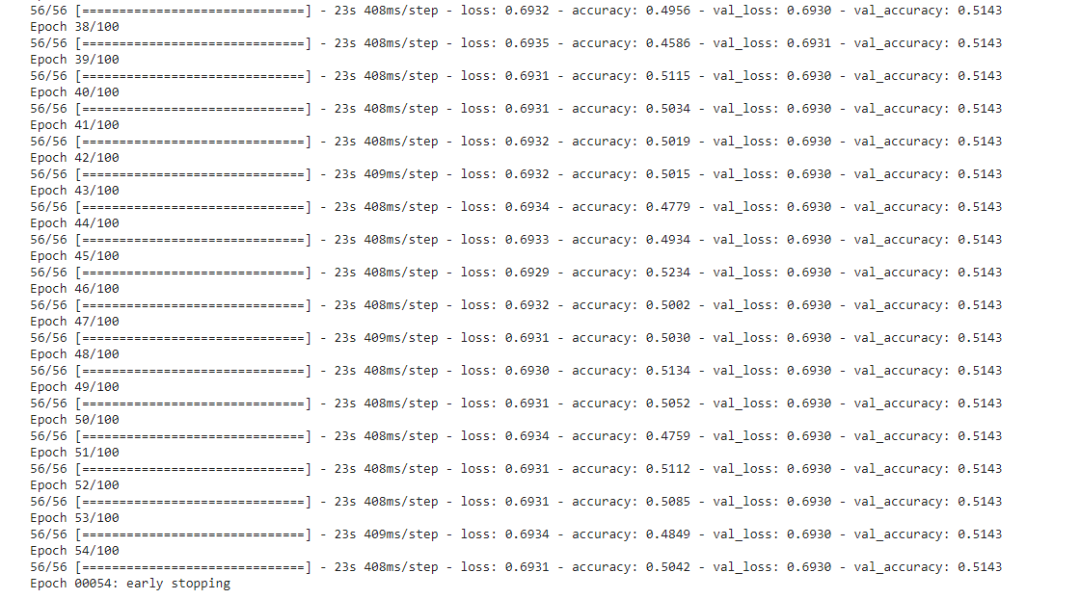
VGG16 Results
NP

Slide 28
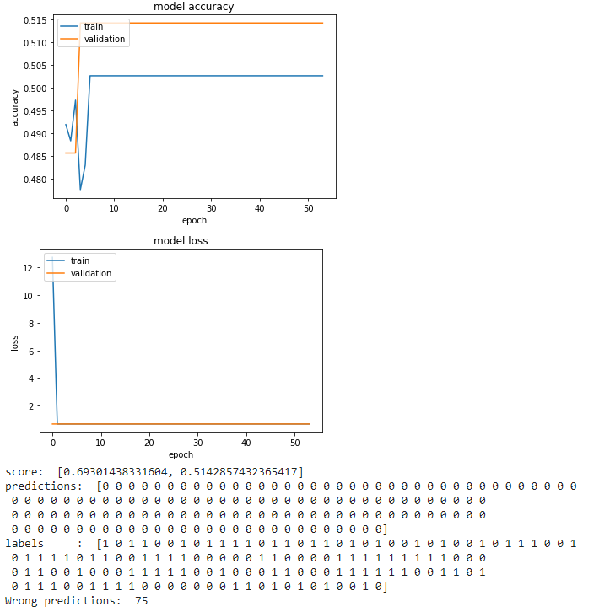
VGG16 Results
NP

Slide 29
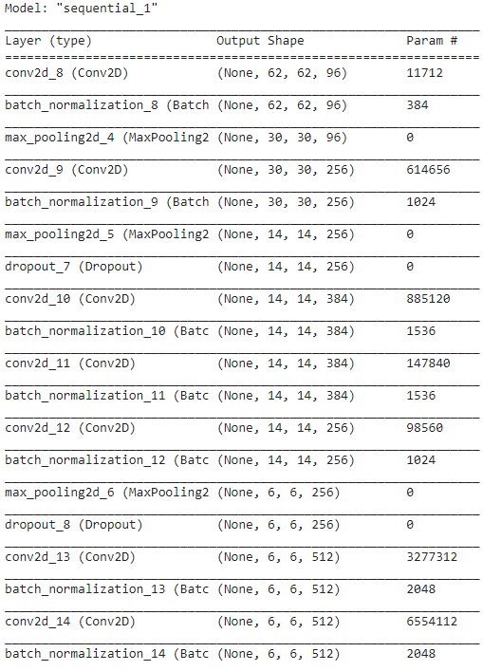
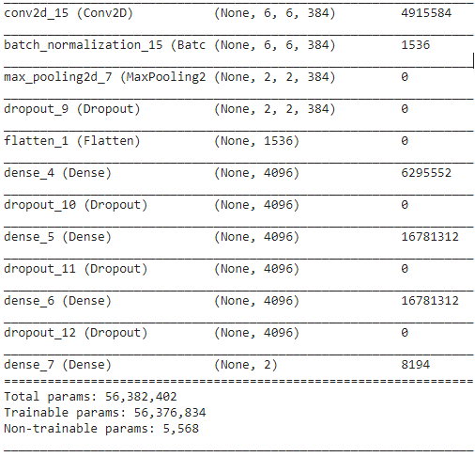
Proposed Architecture
RK
Model Summary:

Slide 30
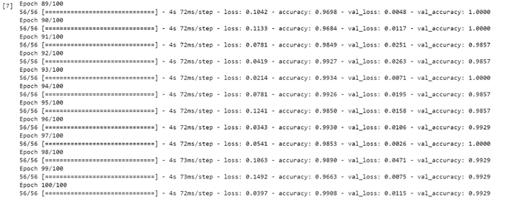
Results
RK

Slide 31
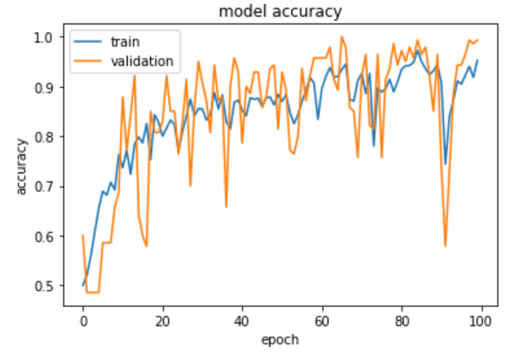
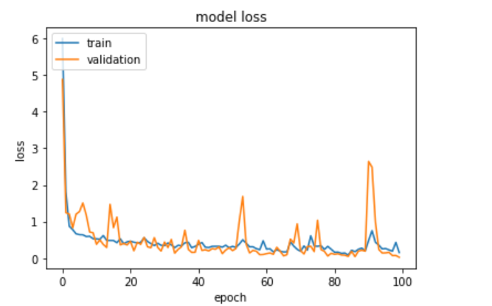
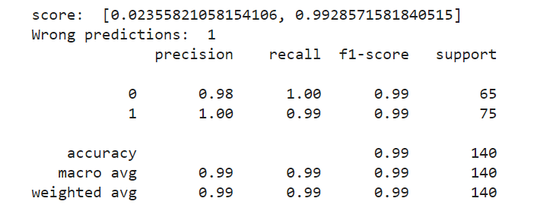
Results
RK
Classification Report

Slide 32
Comparison of architectures
RG
Model | Accuracy | Precision |  | Recall |  | F1 Score |  | Train loss | Validation loss
 |  | 0 | 1 | 0 | 1 | 0 | 1
LeNet | 88.57 | 0.84 | 0.91 | 0.91 | 0.85 | 0.87 | 0.88 | 2.4172e-05 | 0.9127
AlexNet | 89.99 | 0.88 | 0.92 | 0.91 | 0.89 | 0.89 | 0.91 | 0.2752 | 0.9657
VGG16 | 51.43 | 0.46 | 0.00 | 1.00 | 0.00 | 0.63 | 0.00 | 0.6931 | 0.6930
Proposed Model | 99.28 | 0.98 | 1.00 | 1.00 | 0.99 | 0.99 | 0.99 | 0.1812 | 0.0235

Slide 33
Modifications\Novelty
RK
We derived our proposed architecture from AlexNet architecture by adding more convolution layers, fully connected layers, making use of dropouts and, changing the orientation of the layers
Performed hyperparameter tuning by tuning parameters such as kernel size, number of filters, batch size, number of epochs, padding, stride and making use of early stopping in order to improve the performance of the model and to get better accuracy

Slide 34
Conclusion & Future Scope
NP
Developed a lung cancer detection model based on CNN-Deep Learning architecture and could classify the detected nodules as either malignant or benign.
Achieved higher accuracy (99.28%) and performance with the use of image processing techniques and proposed CNN model when compared to other architectures and models we came across during literature survey.
Accuracy and performance of the model can be improved by using
i) Mask R CNN for segmentation
ii) Parallel convolution layers in the architecture

Slide 35
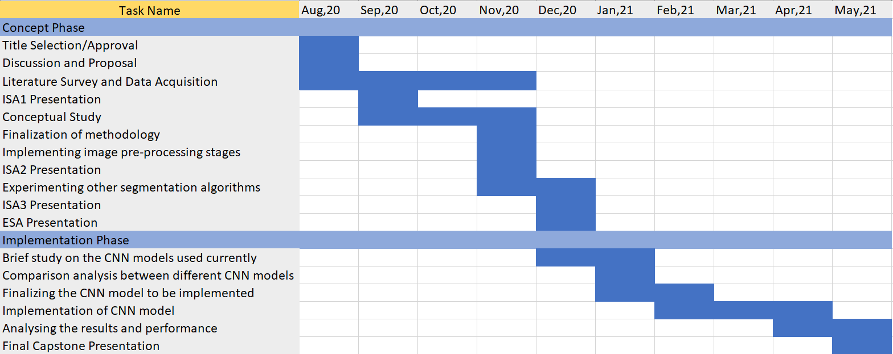
Project timeline
NP
Gantt chart showing milestones of work:

Slide 36
References
[1] Suren Makajua, P.W.C. Prasad, Abeer Alsadoon, A. K. Singh, A. Elchouemi
“Lung Cancer Detection using CT Scan Images”, 6th International Conference on Smart Computing and Communications, 2018
[2] K.Mohanambal , Y.Nirosha , E.Oliviya Roshini , S.Punitha , M.Shamini, “Lung Cancer Detection Using Machine Learning Techniques”, International Journal of Advanced Research in Electrical, Electronics and Instrumentation Engineering, Vol. 8, Issue 2, February 2019
[3] Jeyaprakash Vasanth Wason and Ayyappan Nagarajan, “Image processing techniques for analyzing CT scan images towards the early detection of lung cancer”, Biomedical Informatics, Department of Computer Applications, Alagappa University, September 12, 2019
[4] Ibrahim M. Nasser, Samy S. Abu-Naser, “Lung Cancer Detection Using Artificial Neural Network”, Department of Information Technology, Faculty of Engineering and Information Technology, Al-Azhar University- Gaza, Palestine 2018
[5] Margarita Kirienko,1 Martina Sollini,1,2 Giorgia Silvestri,3 Serena Mognetti,3 Emanuele Voulaz,4 Lidija Antunovic,2 Alexia Rossi,1,5 Luca Antiga,3 and Arturo Chit, Convolutional Neural Networks Promising in Lung Cancer T-Parameter Assessment on Baseline FDG-PET/CT, 2019

Slide 37
References
[6]Vaishnavi. D, Arya. K. S, Devi Abirami. T, M. N. Kavitha, “Lung Cancer Detection Using Machine Learning”, INTERNATIONAL JOURNAL OF ENGINEERING RESEARCH & TECHNOLOGY, VOLUME 7, ISSUE 01, 2019
[7]K. Narmada,G. Prabakaran,”An Effective Lung Cancer Detection And Classification Using Enhanced Fully Convolutional Neural Networks”,INTERNATIONAL JOURNAL OF SCIENTIFIC & TECHNOLOGY RESEARCH VOLUME 9, ISSUE 01, JANUARY 2020
[8]Ashok Kumar Yadav, Ramnaresh, Kamaldeep Joshi, Robin Singh, Shagun Rana, Ashish Krishan, Ritika Sharma,”Lung Cancer Detection by using Adam Algorithm and Convolutional Neural Network”,International Journal of Engineering, Applied and Management Sciences Paradigms,2019
[9]Ibtihal D. Mustafa , Mawia A. Hassan,”A Comparison between Different Segmentation Techniques used in Medical Imaging”,American Journal of Biomedical Engineering 2016, 6(2): 59-69 DOI: 10.5923/j.ajbe.20160602.03
[10]Asifullah Khan, Anabia Sohail1, Umme Zahoora1, and Aqsa Saeed Qureshi1,”A Survey of the Recent Architectures of Deep Convolutional Neural Networks”,Published in Artificial Intelligence Review, DOI: https://doi.org/10.1007/s10462-020-09825-6

Slide 38
Thank You

